Slide 1



自然語言處理與應用 Natural Language Processing and Applications
Hugging Face Tutorial (II)
Instructor: 林英嘉 (Ying-Jia Lin)
2025/04/28
Course GitHub
Slido # NLP_0428

Slide 2
What you will learn in this tutorial
Training and evaluating GPT-2 / T5 on abstractive summarization
Dataset: Chinese abstractive summarization
Objective: Cross-entropy
Main packages: PyTorch, Hugging Face, ROUGE

Slide 3
Why do we need to learn GPT-2?
GPT-2 is the last open-source model in the GPT series from OpenAI.
Language generation is hard, and GPT-2 is a good start point.
GPT-2 is not big. It is feasible for low-budget machines.
GPT-2 (12-layer; 124M), GPT-2-medium (24-layer; 345M), GPT-2-large (36-layer; 762M), GPT-2-xl (48-layer; 1.5B)

Slide 4
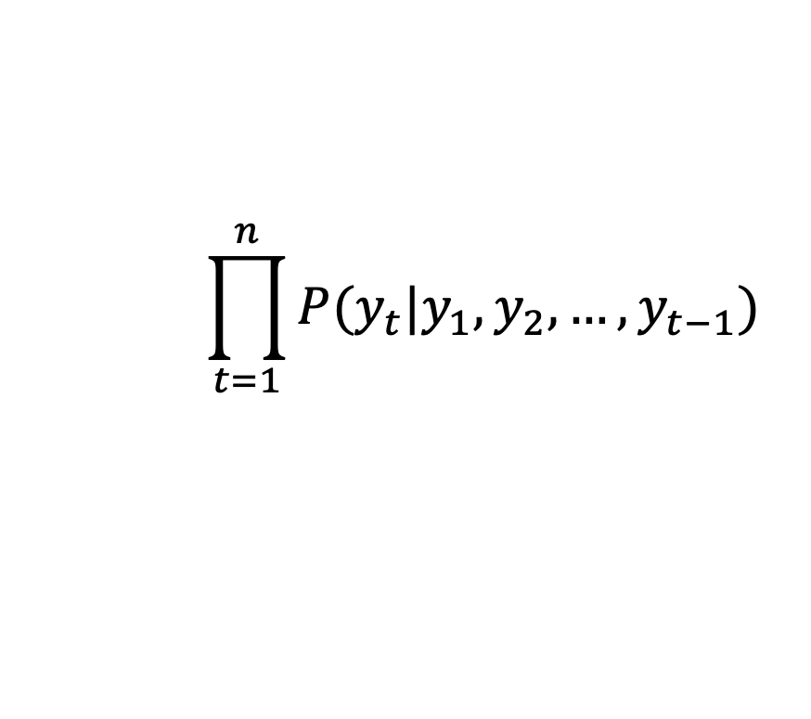

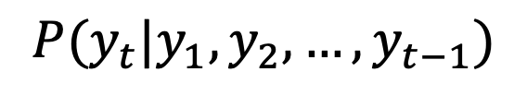
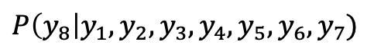
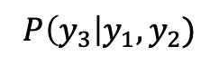
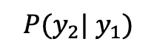
[Recap] 訓練模型最大化每個時間點的機率
模型如何進行預先訓練 (pre-training)？
$$P(y_{t}|y_{1},y_{2},…,y_{t−1})$$
Next-token prediction
$$P(y_{2}| y_{1})$$
$$P\left(y_{3}\right|y_{1},y_{2})$$
$$⋅⋅⋅$$
$$P\left(y_{8}\right|y_{1},y_{2},y_{3},y_{4},y_{5},y_{6},y_{7})$$
y₂
y₃
y₄
y₅
y₆
y₇
y₈
目標函數：
Language Model
$$\prod_{t=1}^{n}{P(y_{t}|y_{1},y_{2},…,y_{t−1})}$$
Language Modeling
y₁
y₂
y₃
y₄
y₅
y₆
y₇
= Generative Pre-training (GPT)
Self-attention 不可及的範圍

Slide 5
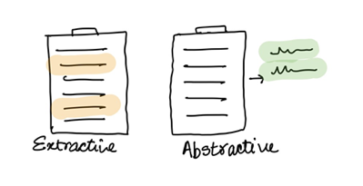
Introduction to Text Summarization
Extractive summarization
Generate a short text summary for a document by selecting salient sentences in the documents.
Abstractive summarization
Generate novel words and phrases not featured in the source text.
Example:
The Queen's Birthday holiday road toll stands at zero for the first time since records began.
Ext summary: The Queen's holiday road toll stands at zero.
Abs summary: The Queen's holiday slashes road toll.

Slide 6
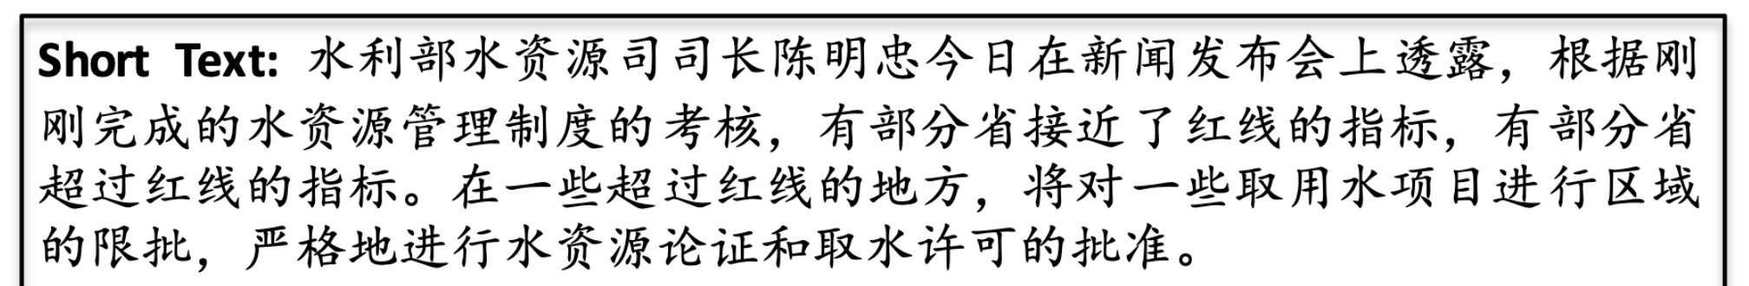
Task: Chinese Abstractive Summarization
Dataset: LCSTS (A Large-Scale Chinese Short Text Summarization Dataset)^{[1]}
[1] Hu, Baotian, Qingcai Chen, and Fangze Zhu. "LCSTS: A Large Scale Chinese Short Text Summarization Dataset." Proceedings of the 2015 Conference on Empirical Methods in Natural Language Processing. 2015.

Slide 7
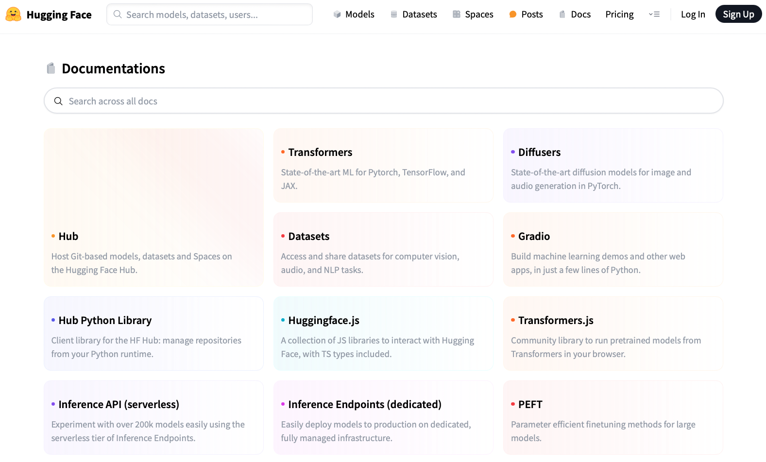
https://huggingface.co/docs

Slide 8
Installation
Basically, you need to install PyTorch first before you install transformers.
(Recommended)
pip install transformers
(If you want to try new things)
git clone https://github.com/huggingface/transformers.git
cd transformers
pip install -e .

Slide 9
Packages required in this tutorial
We need the following packages for this tutorial. On Colab, you may not need to re-install these packages for they may have already been installed.
!pip install torch==2.3.1 --index-url https://download.pytorch.org/whl/cu121
!pip install transformers==4.37.0
!pip install datasets==2.21.0
!pip install accelerate==0.21.0
!pip install rouge==1.0.1
!pip install tqdm==4.66.5
!pip install jieba==0.42.1

Slide 10
Language Model vs. Masked Language Model
y₈
Casual Language Model
(E.g., GPT)
Language Model
y₁
y₂
y₃
y₄
y₅
y₆
y₇
y₄
Masked Language Model
(E.g., BERT)
Masked Language Model (MLM)
y₁
y₂
y₃
?
y₅
y₆
y₇
(Mask)

Slide 11
Language Model vs. Seq2seq Model
y₈
Casual Language Model
(E.g., GPT)
Language Model
y₁
y₂
y₃
y₄
y₅
y₆
y₇
(Target output)
y₁
y₂
y₃
y₄
y₅
y₆
y₇
y₈
Sequence to sequence Model
(E.g., T5; Vanilla Transformers)
Encoder
Decoder
Attention
x₁
x₂
x₃
x₄
x₅
x₆
x₇
x₈
_
y₁
y₂
y₃
y₄
y₅
y₆
y₇
(Source input)
(Start)

Slide 12
Load LCSTS via Hugging Face Dataset
Hugging Face dataset link
raw_train = load_dataset(
"hugcyp/LCSTS", split="train", cache_dir="./cache/"
).to_list()
raw_val = load_dataset(
"hugcyp/LCSTS", split="validation", cache_dir="./cache/"
).to_list()
Sometimes checking the Hugging Face dataset is slow, it will be faster if we transform the dataset object into a list using .to_list().

Slide 13
Auto Classes (models, tokenizers)
In many cases, the architecture you want to use can be guessed from the name or the path of the pretrained model you are supplying to the from_pretrained method.
AutoClasses are here to do this job for you so that you automatically retrieve the relevant model given the name/path to the pretrained weights/config/vocabulary:
Ex: model = AutoModel.from_pretrained('bert-base-cased') will create an instance of the BERT base model (cased).
https://huggingface.co/transformers/v3.0.2/model_doc/auto.html

Slide 14
Generative Models in Auto Classes
Casual Language Model
(E.g., GPT, Llama)
AutoModelForCausalLM (link)
GPT2LMHeadModel (link)
LlamaForCausalLM (link)
Masked Language Model
(E.g., BERT)
AutoModelForMaskedLM (link)
BertForMaskedLM (link)
Sequence to sequence Model
(E.g., T5; Vanilla Transformers)
AutoModelForSeq2SeqLM (link)
T5ForConditionalGeneration (link)

Slide 15
Outline
GPT-2 (native PyTorch)
T5 (Hugging Face Dataset and Trainer)

Slide 16
Import packages
from transformers import AutoTokenizer
from transformers import GPT2LMHeadModel
from datasets import load_dataset
from tqdm import tqdm
import torch
from torch.utils.tensorboard import SummaryWriter
from rouge import Rouge
import jieba

Slide 17
Load the Tokenizer and the Model
Hugging Face model link
model_name = "uer/gpt2-chinese-cluecorpussmall"
tokenizer = AutoTokenizer.from_pretrained(
model_name,
padding_side="left”,
)
tokenizer.add_special_tokens({"eos_token": "<|endoftext|>"})
model.resize_token_embeddings(len(tokenizer))
Optional

Slide 18
Left padding
In text generation, sometimes we set padding_side=’left', when loading tokenizer.
If padding is at the end of the prompt, new tokens may be generated after the padding, which is illogical.
<s> | Recite | the | first | law | <s> | <pad> | <pad> | <pad>
<s> | How | are | you | <s> | <pad> | <pad> | <pad> | <pad>
<s> | Who | is | the | first | president | of | U.S. | <s>
Left-padding
Aligning the new tokens.
<pad> | <pad> | <pad> | <s> | Recite | the | first | law | <s>
<pad> | <pad> | <pad> | <pad> | <s> | How | are | you | <s>
<s> | Who | is | the | first | president | of | U.S. | <s>

Slide 19
About Padding
When fine-tuning GPT-2
Left padding + set [PAD] as -100 in labels (this tutorial)
Right padding + set [PAD] as -100 in labels
When using GPT-2 for test (inference time)
Use test_batch_size as 1 (this tutorial)
Left padding

Slide 20
Set [PAD] as -100 in labels
https://github.com/huggingface/transformers/blob/main/src/transformers/models/gpt2/modeling_gpt2.py#L1264-L1267
r"""
labels (`torch.LongTensor` of shape `(batch_size, sequence_length)`, *optional*):
Labels for language modeling. Note that the labels **are shifted** inside the model, i.e. you can set
`labels = input_ids` Indices are selected in `[-100, 0, ..., config.vocab_size]` All labels set to `-100`
are ignored (masked), the loss is only computed for labels in `[0, ..., config.vocab_size]`
"""

Slide 21
Load the Tokenizer and the Model
Hugging Face model link
model_name = "uer/gpt2-chinese-cluecorpussmall"
tokenizer = AutoTokenizer.from_pretrained(
model_name,
padding_side="left”,
)
tokenizer.add_special_tokens({"eos_token": "<|endoftext|>"})
model.resize_token_embeddings(len(tokenizer))
Increasing the size will add newly initialized vectors at the end. Reducing the size will remove vectors from the end. (link)

Slide 22
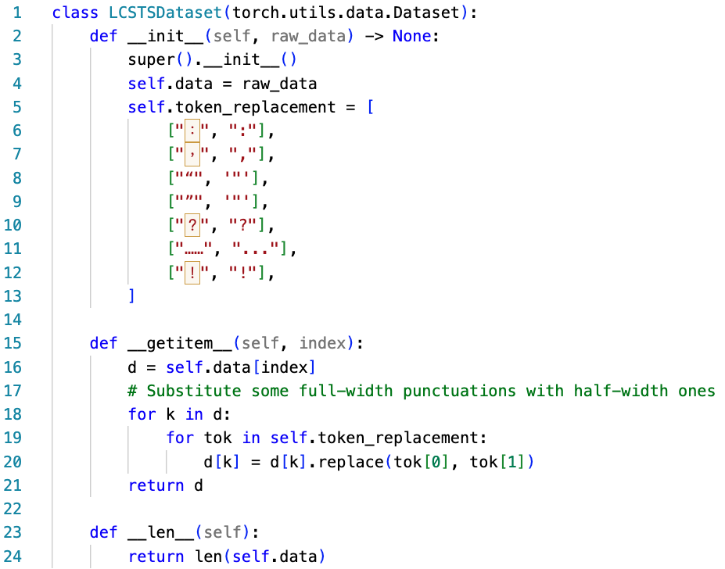
Create the PyTorch Dataset
To prevent out-of-vocabulary tokens from being transformed into [UNK]
You can use the Hugging Face dataset without building a PyTorch dataset class.
However, language generation is really complicated. We suggest building your first code with native PyTorch.
Run:
train_set = LCSTSDataset(raw_train)
val_set = LCSTSDataset(raw_val)

Slide 23
Create the PyTorch DataLoader for Data Batching
Input data for training (source + summary)
Labels (auto-regressive; thus, basically input_ids themselves)
Input data for predictions (source only)

Slide 24
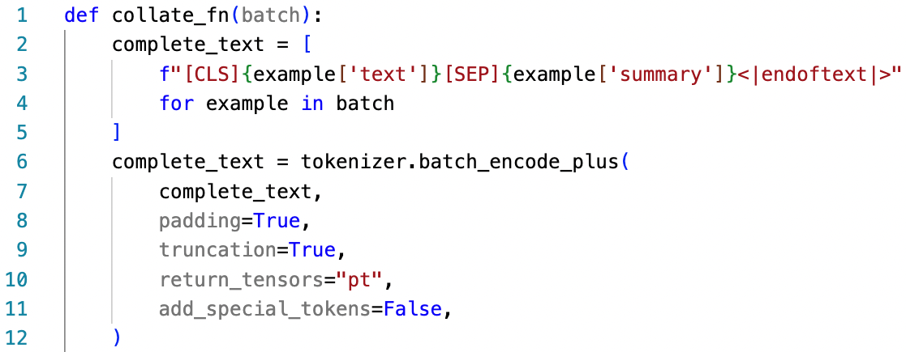
Create the PyTorch DataLoader for Data Batching: 1. Input Data for Training
You can omit the [CLS] token before fine-tuning!
[CLS]
Source article
[SEP]
Summary
<|endoftext|>

Slide 25
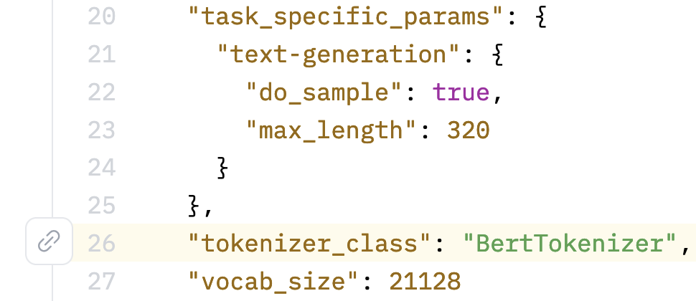
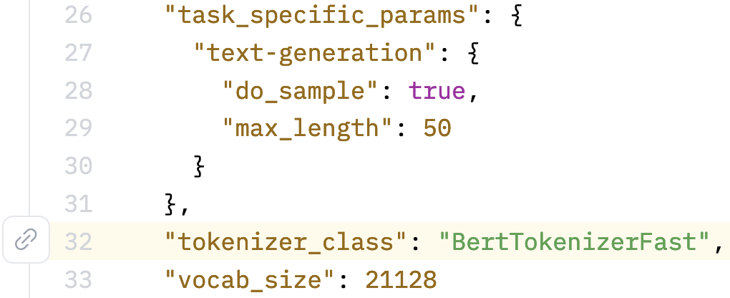
uer/gpt2-chinese-cluecorpussmall uses BertTokenizer
https://huggingface.co/uer/gpt2-chinese-cluecorpussmall/blob/main/config.json#L26
https://huggingface.co/ckiplab/gpt2-base-chinese/blob/main/config.json#L32

Slide 26
English GPT-2 for Text Summarization^{[2]}
> To induce summarization behavior, we add the text TL;DR: after the article ^{[2]}
TL;DR
Ideally, the model may learn [SEP] as a signal to perform summarization.
[CLS]
Source article
[SEP]
Summary
<|endoftext|>
(You can try it.)
Ideally, the model may learn <|endoftext|> as a signal to end generation.
[2] Radford, A., Wu, J., Child, R., Luan, D., Amodei, D., & Sutskever, I. (2019). Language models are unsupervised multitask learners. OpenAI blog, 1(8), 9.

Slide 27
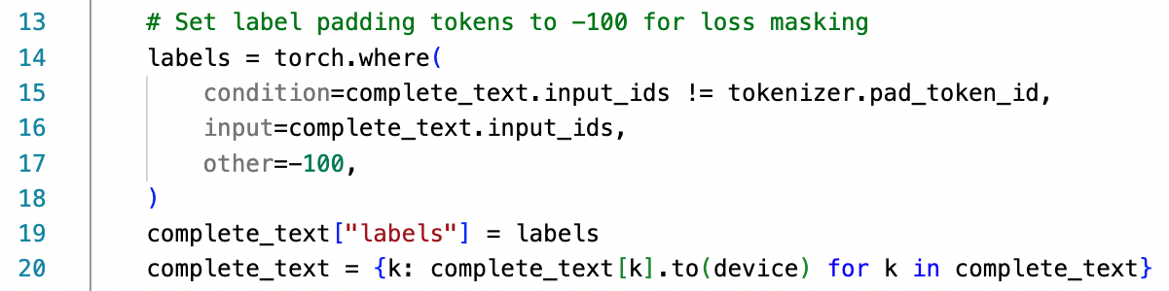
Create the PyTorch DataLoader for Data Batching: 2. Labels (auto-regressive)
(We are still at the collate_fn function.)
This is sentence A.
This is is is sentence B.
[PAD]
[PAD]
this
is
sentence
a
labels
-100
-100
1212
318
6827
317
this
is
is
is
sentence
b
labels
1212
318
318
318
6827
347

Slide 28
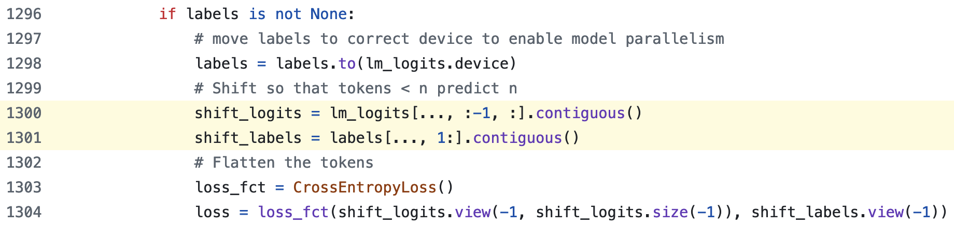
GPT2LMHeadModel shifts logits and labels
https://github.com/huggingface/transformers/blob/main/src/transformers/models/gpt2/modeling_gpt2.py#L1300-L1301
Shape of lm_logits: [batcg_size, seq_length, hidden_size]
:-1 代表取到倒數第二個
1: 代表答案後移一格
.contiguous(): https://youtu.be/FGJSGAt_9Ks?si=GMxxS2Oi742e2BhI&t=1261

Slide 29
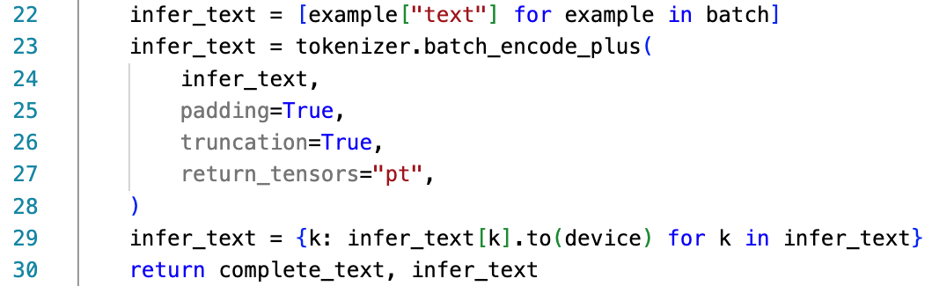
Create the PyTorch DataLoader for Data Batching: 3. Input Data for Predictions
(We are still at the collate_fn function.)
We will use `infer_text` during evaluations.
If you omit the [CLS] token during fine-tuning, then you don’t need to add [CLS] before evaluations!
[CLS]
Source article
[SEP]
Summary
<|endoftext|>

Slide 30
Create the PyTorch DataLoader for Data Batching: 1. Input Data for Training [Recap]
You can omit the [CLS] token before fine-tuning!
[CLS]
Source article
[SEP]
Summary
<|endoftext|>

Slide 31
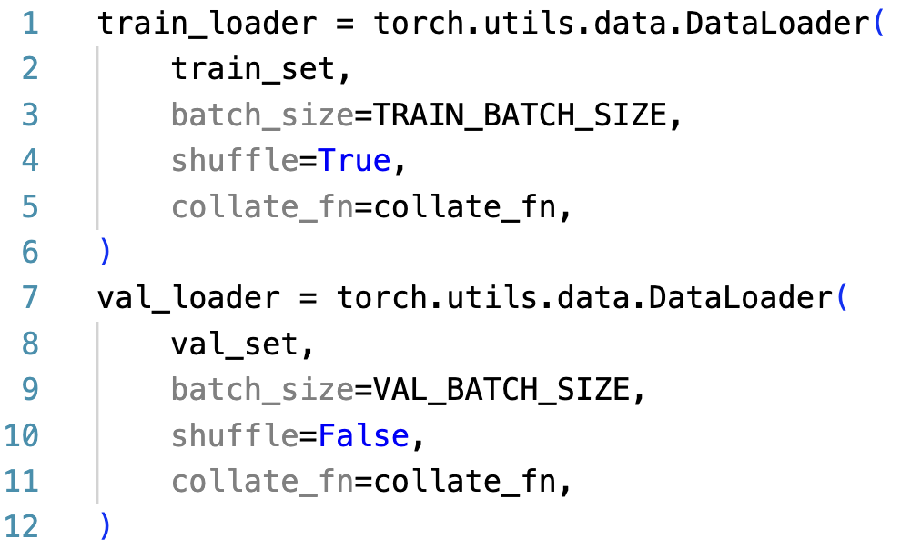
Create the PyTorch DataLoader for Data Batching
Prevent a model from overfitting on data order
We don’t need to use the test set because there is no public test labels (summaries).
See https://huggingface.co/datasets/hugcyp/LCSTS/viewer/default/test

Slide 32
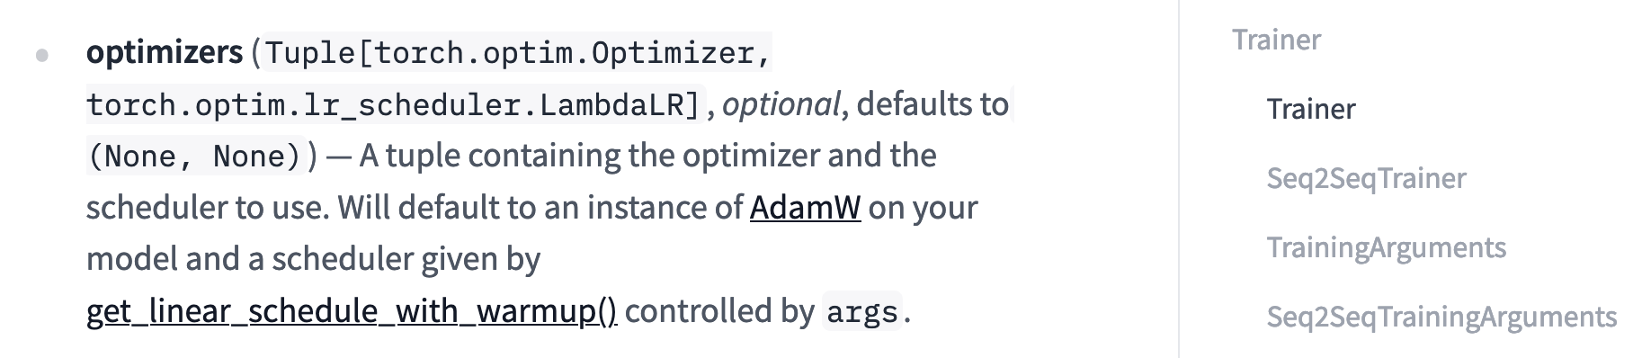
Set up Optimizer
optimizer = torch.optim.AdamW(model.parameters(), lr=LR)
https://pytorch.org/docs/stable/generated/torch.optim.AdamW.html
https://huggingface.co/docs/transformers/main_classes/trainer

Slide 33
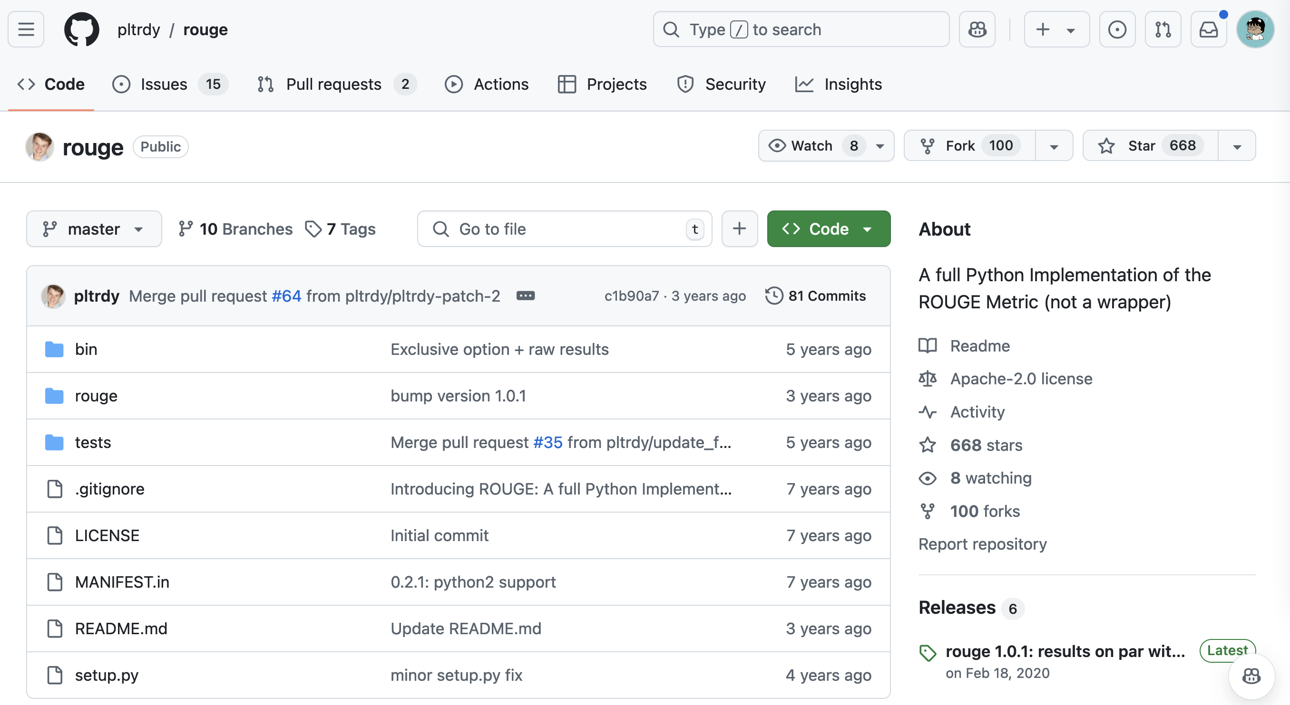
Set up Evaluation Metric
rouge_metric = Rouge()
https://github.com/pltrdy/rouge

Slide 34
ROUGE Score^{[3]}
ROUGE (Recall-Oriented Understudy for Gisting Evaluation)
Mainly for text summarization
Metric Input: Summary (prediction), Reference (gold summary)
Common metrics: ROUGE-1, ROUGE-2, ROUGE-L
L: Longest common subsequence
Please note that current papers calculate ROUGE-F as default!!!
In other words, ROUGE-1F, ROUGE-2F, ROUGE-LF
Lin, Chin-Yew. "Rouge: A package for automatic evaluation of summaries." Text summarization branches out. 2004.

Slide 35
ROUGE-1 Example
predictions = ["The", "cat", "sat", "on", "the", "mat"]
references = ["A", "cat", "was", "sitting", "on", "the", "mat"]
ROUGE-1 recall = Number of matching unigrams / Number of unigrams in the reference = 4/7
ROUGE-1 precision = Number of matching unigrams / Number of unigrams in the machine-generated summary = 4/6
ROUGE-1 F1-score = Harmonic mean of the precision and the recall = 2 * 4/7 * 4/6 / (4/7 + 4/6)

Slide 36
Generating step-by-step
y₁
y₂
y₃
y₄
y₅
y₆
y₇
y₈
Casual Language Model
(E.g., GPT)
Language Model
_
y₁
y₂
y₃
y₄
y₅
y₆
y₇
Training time: update the model through hidden states
Test time: perform decoding for each step

Slide 37
Decoding strategies
Popular decoding strategies:
Greedy decoding
Beam search
Top-k sampling
Top-p sampling
https://huggingface.co/blog/how-to-generate

Slide 38
How to let a model generate step-by-step?
We can use model.generate()
There are two main advantages of model.generate():
We don’t need to write a decoding loop on our own.
We don’t need to implement decoding strategies by ourselves.
[Useful!!] https://huggingface.co/blog/how-to-generate

Slide 39
Perform Evaluations
Input:
[CLS]
Source article
[SEP]
Expected output of model.generate():
[CLS]
Source article
[SEP]
Summary
<|endoftext|>
Gold:
Summary

Slide 40
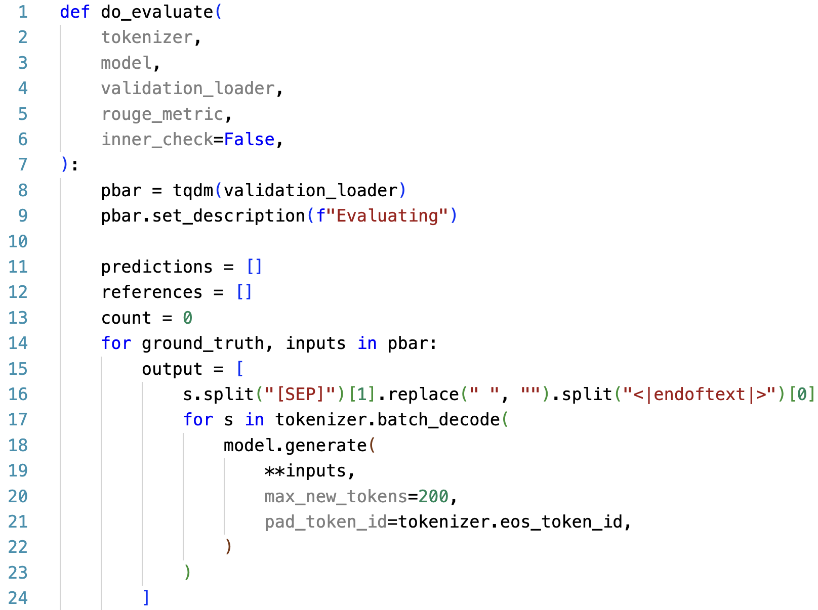
Perform Evaluations
Output Part
Expected output of model.generate():
[CLS]
Source article
[SEP]
Summary
<|endoftext|>

Slide 41
Create the PyTorch DataLoader for Data Batching: 3. Input Data for Predictions
(We are still at the collate_fn function.)
We will use `infer_text` during evaluations.
If you omit the [CLS] token during fine-tuning, then you don’t need to add [CLS] before evaluations!
[CLS]
Source article
[SEP]
Summary
<|endoftext|>

Slide 42
Perform Evaluations
If you don’t set max_new_tokens, Hugging Face will also count the input tokens!
Output Part

Slide 43
Perform Evaluations
For each batch, first finished sentences should have <|endoftext|> rather than [PAD] at the end.
Output Part
More details: https://github.com/huggingface/transformers/blob/b880508440f43f80e35a78ccd2a32f3bde91cb23/src/transformers/generation_utils.py#L1248-L1251

Slide 44
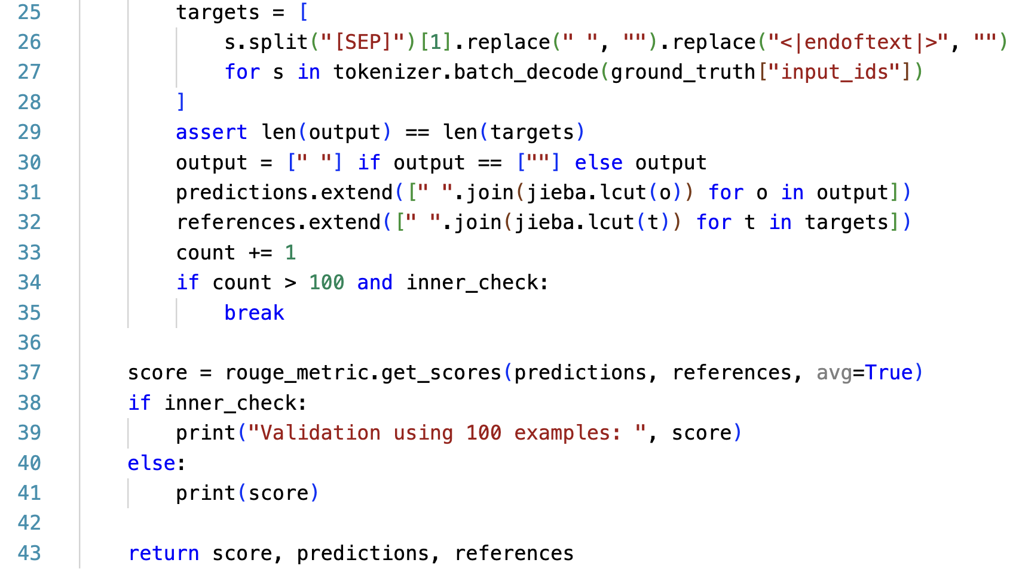
Perform Evaluations
Target and Scoring Parts
ground_truth:
[CLS]
Source article
[SEP]
Summary
<|endoftext|>

Slide 45
Perform Evaluations
Target and Scoring Parts
Character-level bi-gram: (「看」、「電」)(「電」、「視」)
Word-level bi-gram: (「看」、「電視」)

Slide 46
Perform Evaluations
Target and Scoring Parts
avg=True: perform averaging for all the tested instances

Slide 47
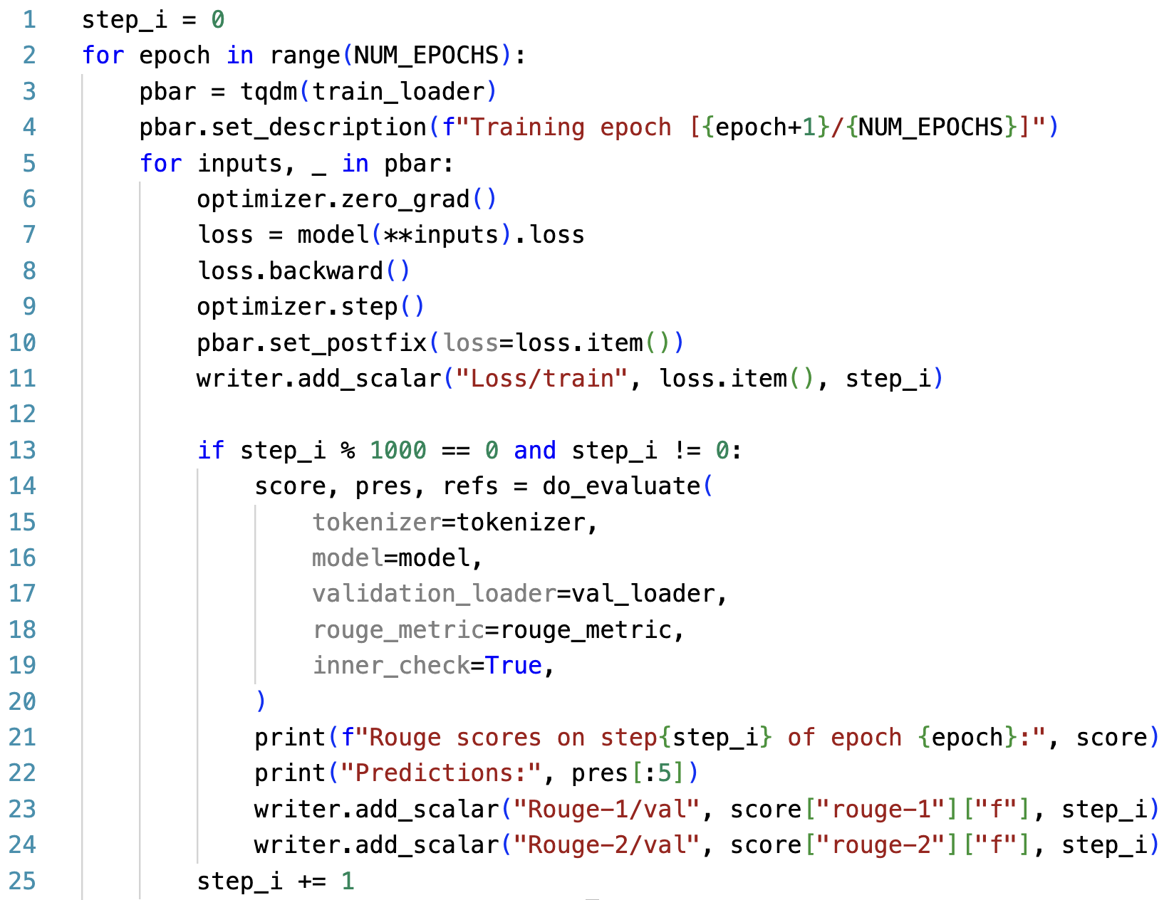
Training Loop
Evaluating the subset of the validation data at each 1,000 steps

Slide 48
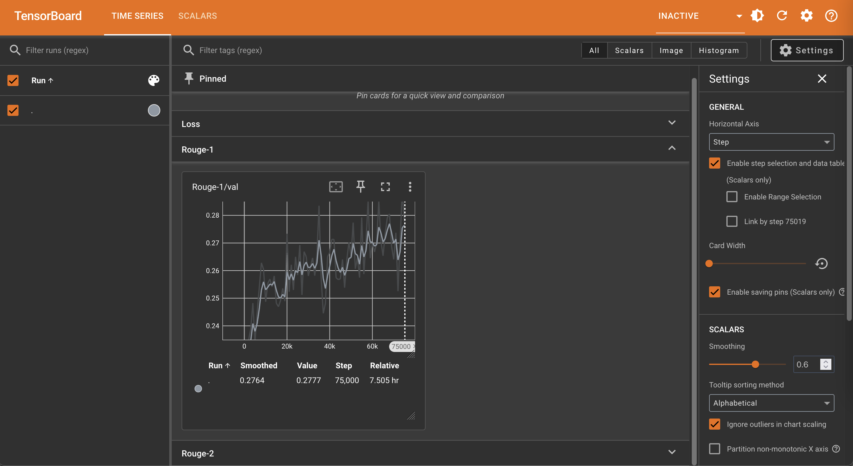

Slide 49
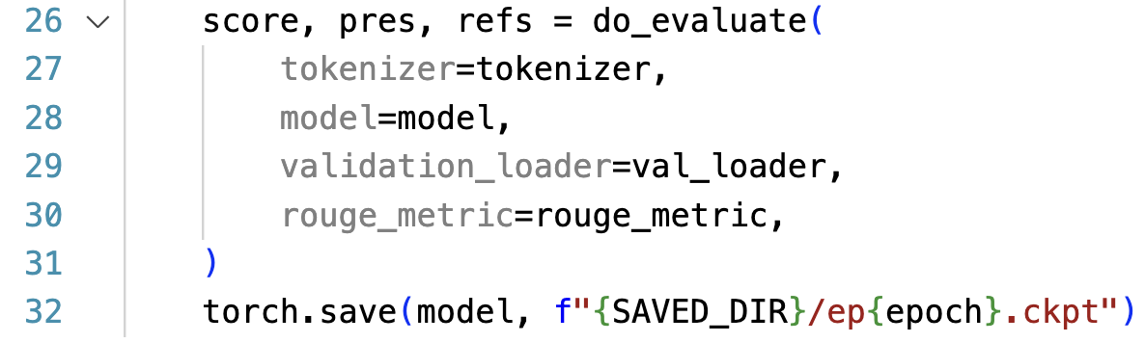
Training Loop
Evaluating the full validation set at each end of epoch

Slide 50
Outline
GPT-2 (native PyTorch)
T5 (Hugging Face Dataset and Trainer)

Slide 51
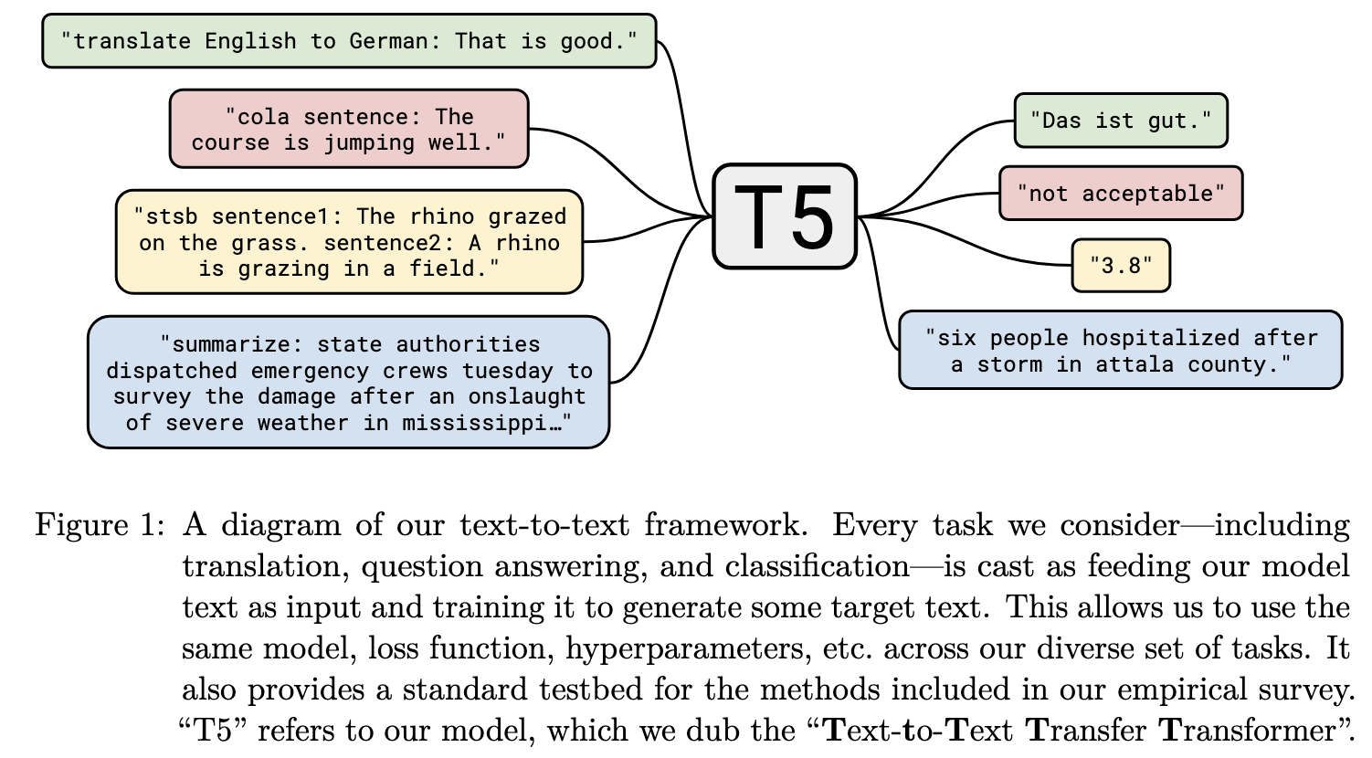
T5 ^{[4]}
[4] Raffel, Colin, et al. "Exploring the limits of transfer learning with a unified text-to-text transformer." Journal of machine learning research 21.140 (2020): 1-67.

Slide 52
Language Model vs. Seq2seq Model
y₈
Casual Language Model
(E.g., GPT)
Language Model
y₁
y₂
y₃
y₄
y₅
y₆
y₇
(Target output)
y₁
y₂
y₃
y₄
y₅
y₆
y₇
y₈
Sequence to sequence Model
(E.g., T5; Vanilla Transformers)
Encoder
Decoder
Attention
x₁
x₂
x₃
x₄
x₅
x₆
x₇
x₈
_
y₁
y₂
y₃
y₄
y₅
y₆
y₇
(Source input)
(Start)

Slide 53
Import packages
from transformers import AutoTokenizer
from transformers import AutoModelForSeq2SeqLM
from transformers import DataCollatorForSeq2Seq
from transformers import Seq2SeqTrainingArguments
from transformers import Seq2SeqTrainer
from datasets import load_dataset
from rouge import Rouge
import numpy as np
import pickle
import os
import jieba

Slide 54
Load the LCSTS dataset
Hugging Face dataset link
data_name = "hugcyp/LCSTS"
raw_train = load_dataset(data_name, split="train")
raw_valid = load_dataset(data_name, split="validation")
raw_small_valid = raw_valid.select(range(100))
raw_small_valid will be used for inner_check (validation).
We will later process the dataset with the built-in map function, so we don’t use.to_list() here.

Slide 55
Load the Tokenizer and the Model
Hugging Face model link
model_name = "google/mt5-small"
tokenizer = AutoTokenizer.from_pretrained(model_name)
model = AutoModelForSeq2SeqLM.from_pretrained(model_name)
Q1: Do we need left-padding?
A1: No, because we are now using a sequence-to-sequence model, which will first compress input sequences though the encoder.
Q2: Do we need to add [EOS] by ourselves?
A2: No, mT5 has </s> as the [EOS] token.

Slide 56
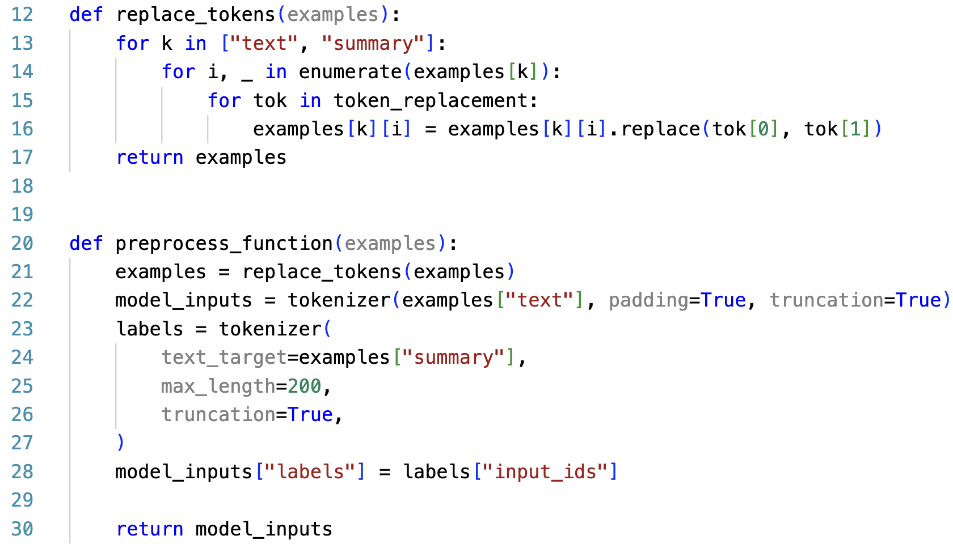
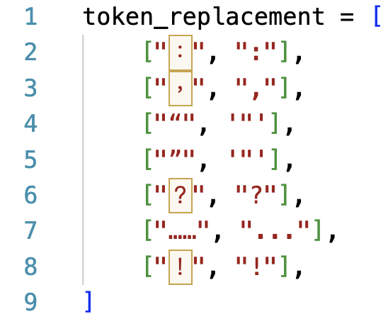
Data pre-processing (inputs; source articles)

Slide 57
Data pre-processing (labels; summaries)

Slide 58
Data pre-processing (executions)
train = raw_train.map(preprocess_function, batched=True)
valid = raw_valid.map(preprocess_function, batched=True)
small_valid = raw_small_valid.map(preprocess_function, batched=True)
data_collator = DataCollatorForSeq2Seq(
tokenizer=tokenizer,
model=model_name,
)
DataCollatorForSeq2Seq dynamically pads batched data and transforms padded labels into -100.
The operation provided by this object does a similar job like collate_fn.

Slide 59
Set up Evaluation Metric
rouge_metric = Rouge()
https://github.com/pltrdy/rouge

Slide 60
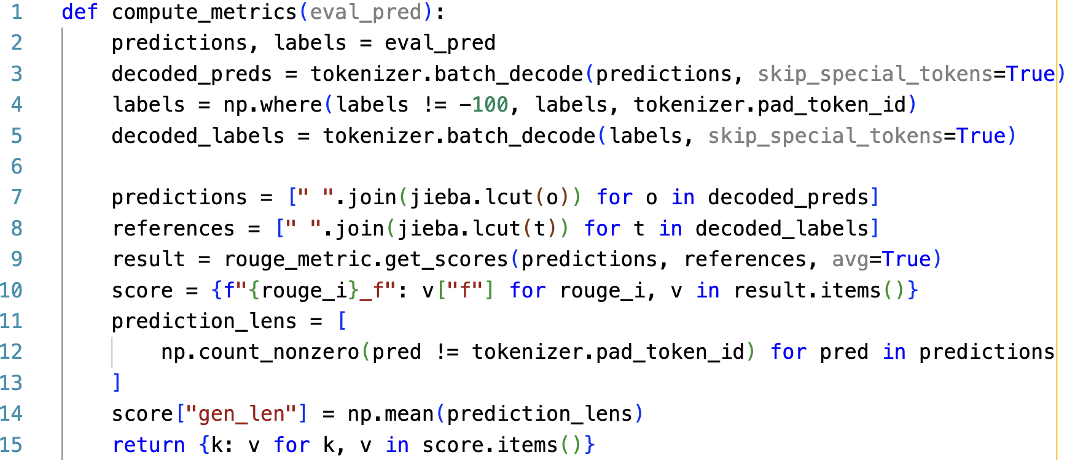
Build compute_metrics for evaluations
-100 is transformed by DataCollatorForSeq2Seq.
Convert labels with -100 to pad_token_id for decoding.

Slide 61
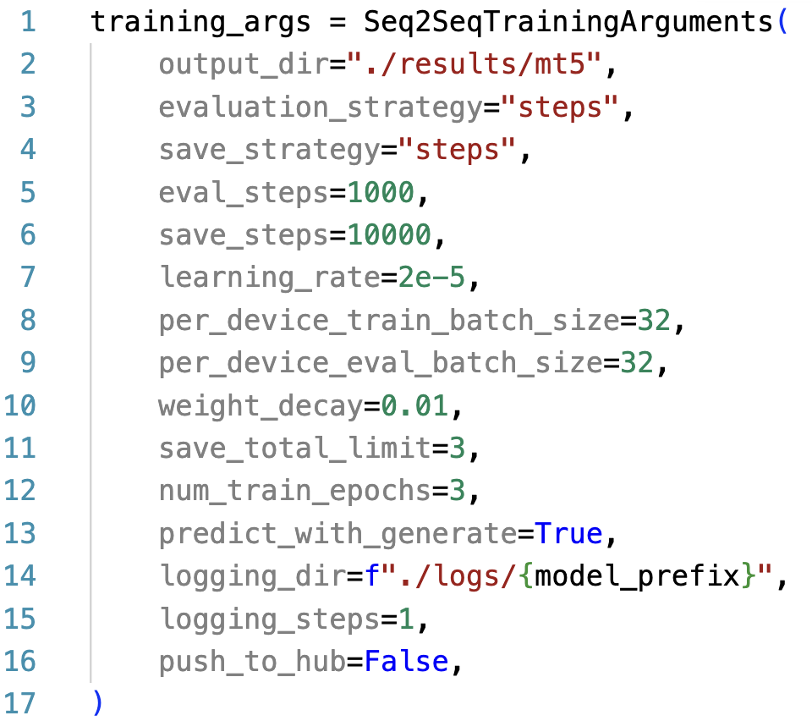
Setting up TrainingArguments (link)
Default using Greedy search. Seq2seqTrainer Supports beam search only.

Slide 62
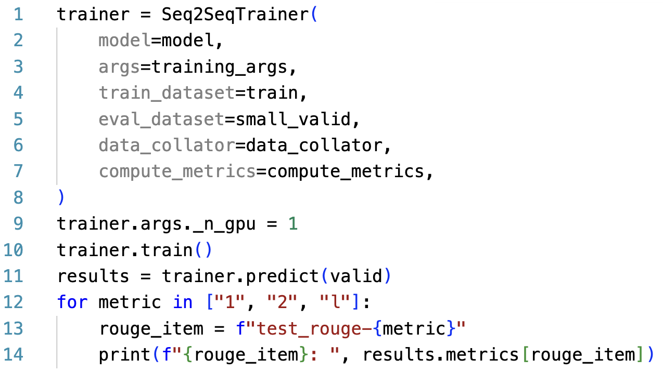
Setting up Trainer (training part)

Slide 63
Setting up Trainer (evaluation part)

Slide 64
Thank you!
Instructor: 林英嘉
✉️ yjlin@cgu.edu.tw
TA: 吳宣毅
✉️ m1161007@cgu.edu.tw

